Slide 1
Blockchain
Technology

Slide 2
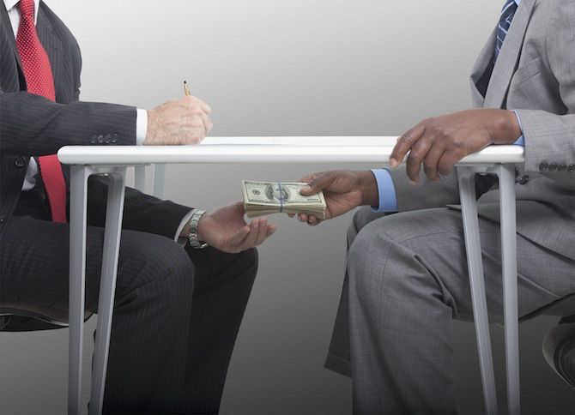
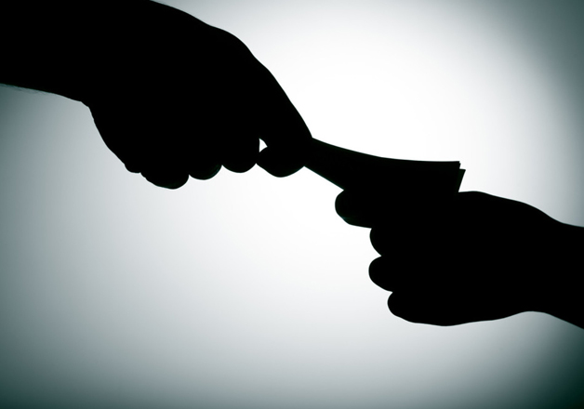
Corruption
Black Money
Notes:
Type of slide: Intro

Slide 3
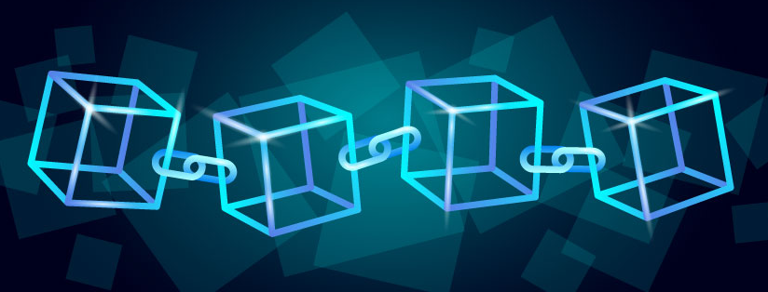
What is Blockchain?
Blockchain is a distributed ledger technology that allows secure and transparent transactions without the need for intermediaries. It is a decentralised system that uses cryptography to ensure data integrity and immutability.
Notes:
Type of slide: Intro

Slide 4
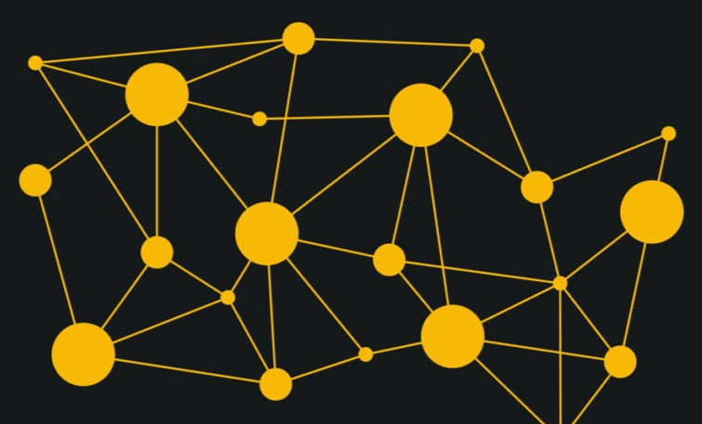
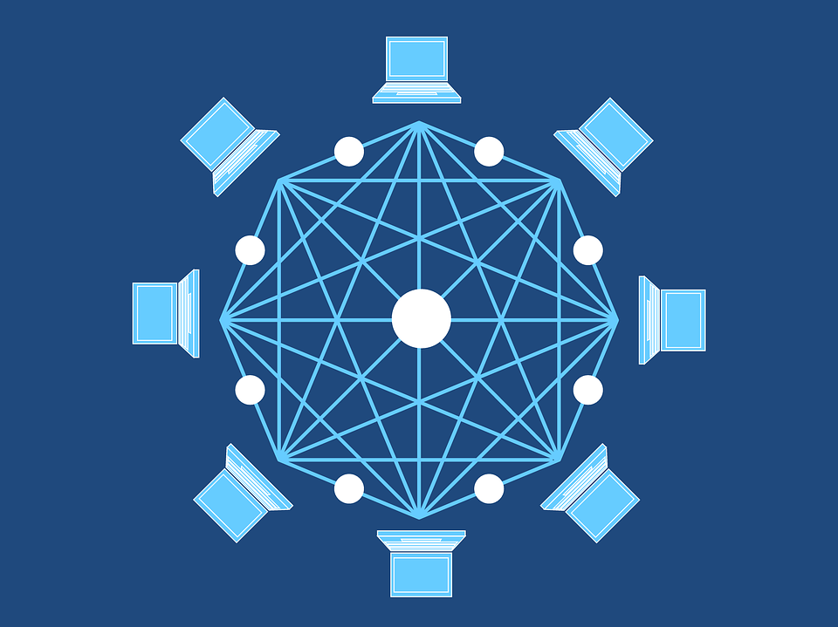
Decentralised
System
Notes:
Type of slide: Intro

Slide 5
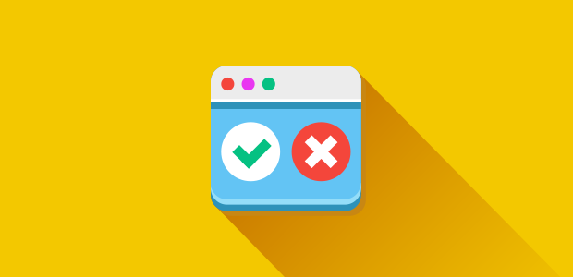


3. Transparency and Accountability: This process unveils any attempts at data tampering, as participants can identify the perpetrator and collectively decide whether the change should be accepted or rejected.
4. Democratic Governance: The network's voting mechanism fosters a democratic approach to data management, ensuring that changes align with the consensus of the majority.
1. Data Integrity: The shared database ensures that no single individual can unilaterally modify the data, preserving its integrity.
2. Network Consensus: Any proposed changes trigger a network-wide notification, allowing all participants to vote on the alteration's validity.

Slide 6
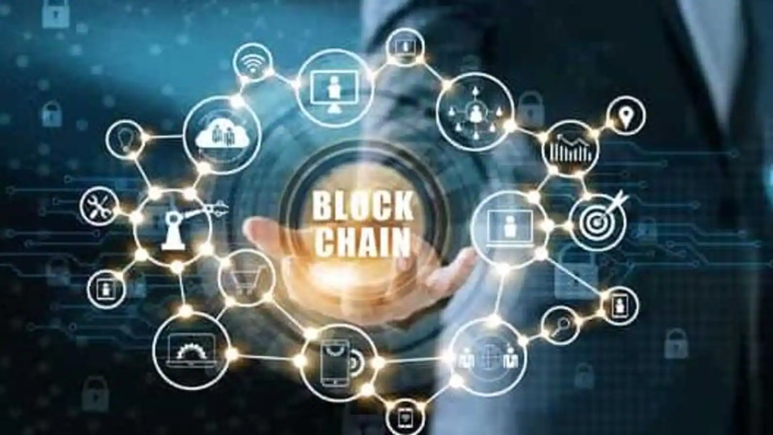
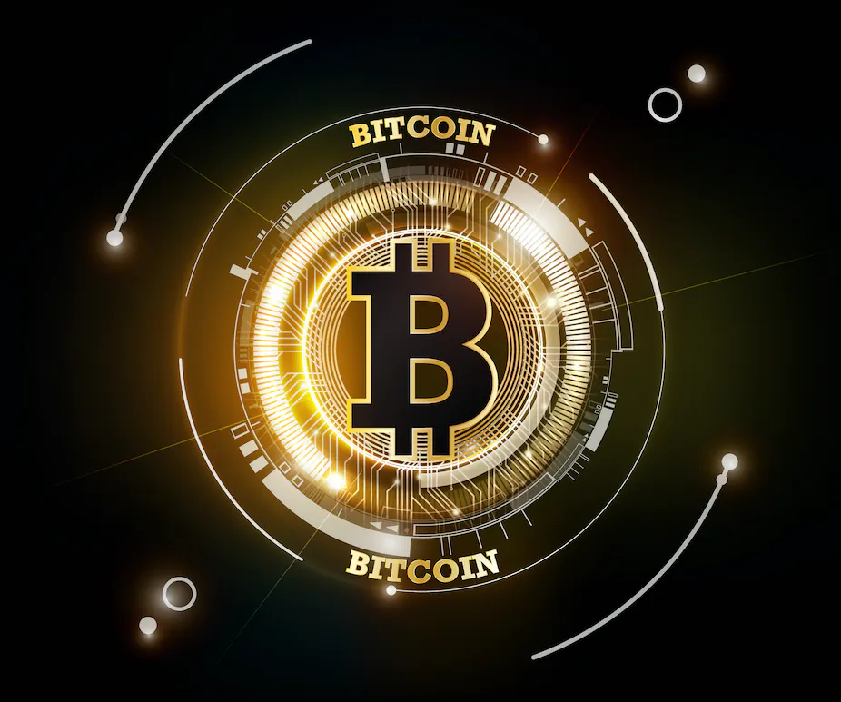
1990's
2009

Slide 7
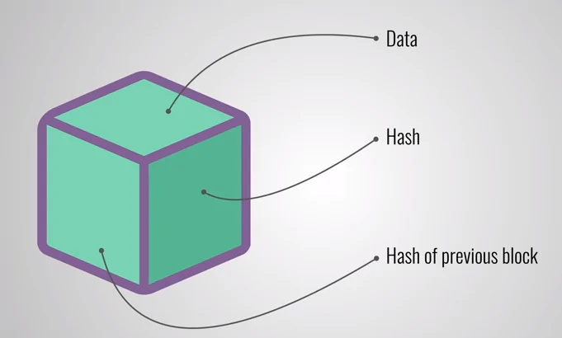

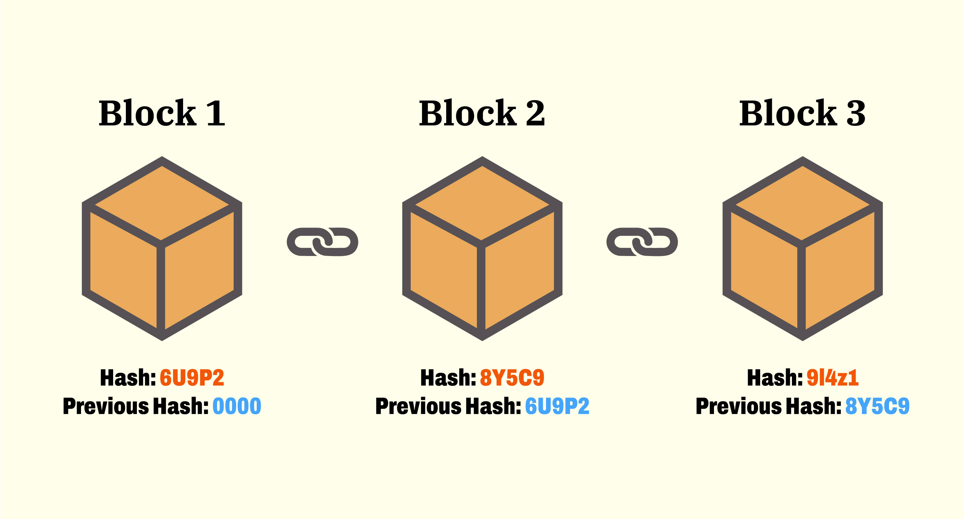
Blocks in
Blockchain
represents
records
Genesis

Slide 8
Blockchain Advantages :
STORING HISTORY OF EACH BLOCK
EASY TO TRACK DETAILS
DIFFICULT TO MAKE CHANGES

Slide 9
If anyone try to change data:
5YUO9

Slide 10
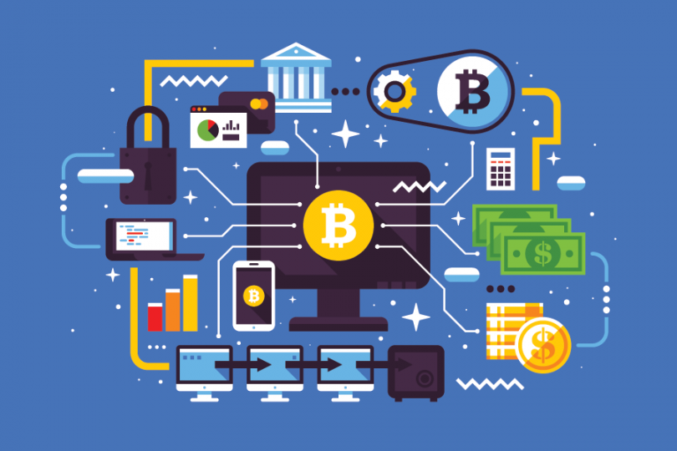
Applications of Blockchain:
Blockchain technology has potential applications in various industries, including finance, healthcare, supply chain management, and voting. It can be used to create secure and transparent systems for transactions, record-keeping, and data sharing.

Slide 11
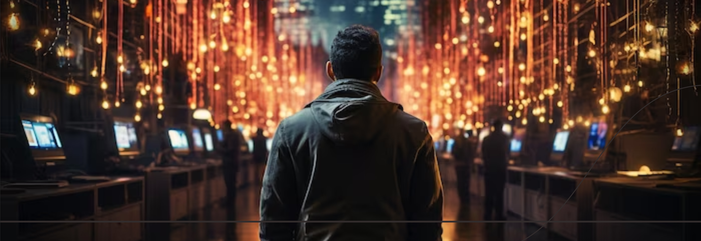
The future of blockchain technology looks promising, with potential applications in various industries and ongoing developments to address its challenges. As the technology continues to evolve, we can expect to see more innovative use cases and solutions.

Slide 12
Thank
You!!

